Slide 1

DISTRIBUTED FILE SYSTEM
Principles of Computer Security(CMSC 626)
Final Project
Team :
Sai Kumar Vaddepally (ci94858@umbc.edu),
Vamshi Krishna Ginna (ty66290@umbc.edu),
Harsha Meghana Reddy Guntaka (lb2345@umbc.edu),
Mohan Manjunath Gujjar (m349@umbc.edu),
Saketh Ram Vangeepuram (xv45698@umbc.edu)

Slide 2

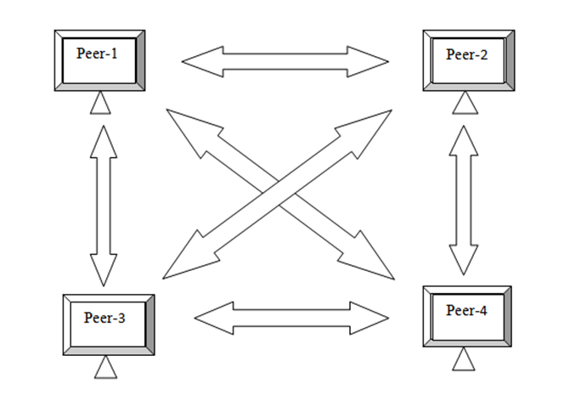
OVERVIEW
Introduction
The traditional storage methods for data storage and access lack security, making it difficult for users to store and retrieve data securely.
A solution to this is the Distributed File System, which divides the data into small chunks and stores it across multiple systems.
Peer-to-peer communication is a method of communication where devices communicate with encrypted data, making every device a client and server.
P2P technology is used for content sharing, and examples include Napster, WhatsApp, Gnutella, and Freenet. An encrypted distributed file system with a P2P architecture has been created using the Fernet algorithm to provide rigorous permissions while allowing basic file operations.
File replicas are encrypted on at least three separate peers to ensure redundancy, prevent data loss and allow for secure P2P file sharing with encrypted communication to prevent data tampering.
The system allows multiple users to perform operations simultaneously while maintaining ACID properties to ensure data consistency and reliability.
Peer-to-peer communication

Slide 3
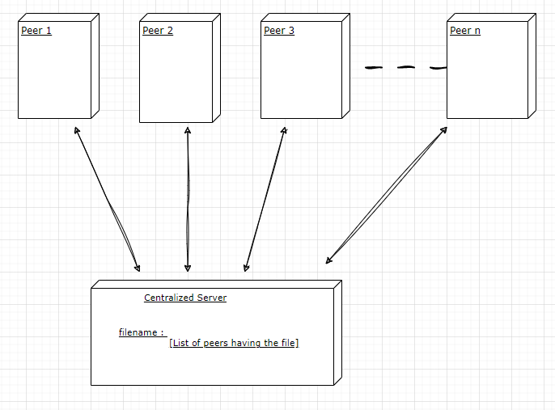
OVERVIEW
System Design:
There are 2 main entities:
Centralized Server: stores the information of all the connected peers and their IP addresses
Peer: Independent node
Operations:
Created file
Read file
Update file
Delete file
Restore file
Centralized Peer-to-Peer architecture

Slide 4
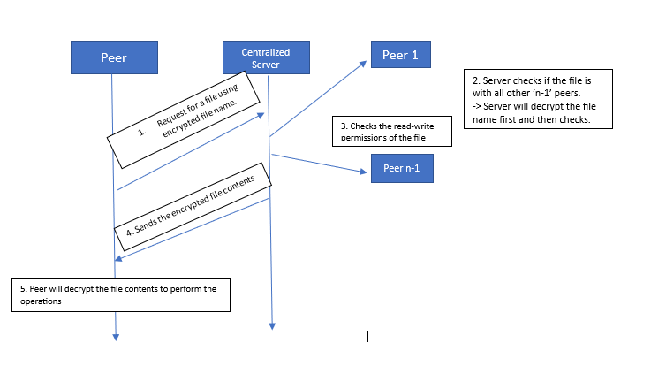
OVERVIEW
Encryption :
The Centralized Server(CS) will assign each user a unique secret key for the encryption. The same key is used to encrypt and decrypt the file contents.
To achieve encryption, we used the Fernet from Python's cryptography package. Fernet uses AES in CBC mode with a 128-bit key for encryption using PKCS7 padding.
Fernet guarantees that a message encrypted using it cannot be manipulated or read without the key. Fernet implements symmetric (or “secret key”) authenticated cryptography.
Encryption algorithm in action

Slide 5
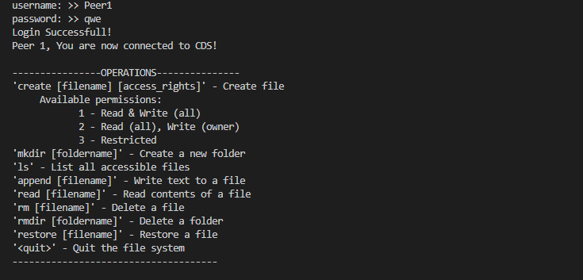
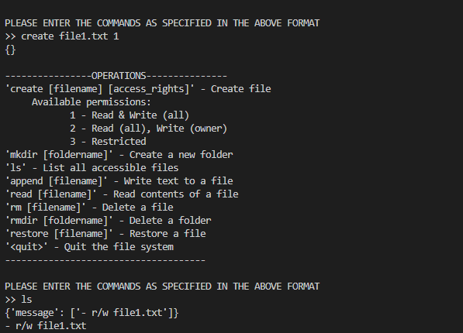
OVERVIEW
Screenshots
Logging in with credentials and connecting to CS
Creating a file with read-write permissions and listing the files

Slide 6
OVERVIEW
Conclusion
We have developed a Peer-to-Peer Encrypted Distributed file system(DFS) using Python Programming Language. The present distributed file system (DFS) included Fernet encryption and all the other components required for a reliable P2P-based system. We thoroughly tested the DFS with four peers to ensure all CRUD operations worked correctly.
This project can be further improved to support other types of files apart from txt files.
We can build a GUI(Graphical User Interface) for performing CRUD operations, making a user-friendly system.
We can make the current file system more consistent and reliable by adding consistency protocols and fault tolerance.

Slide 7
THANK YOU

